Slide 1
COVID-19 Twitter Sentiment Analysis Model
Team: Interceptor
Member(s): Veni S

Slide 2
Introduction
This project is about the sentiment analysis of Indians after the extension of lock down announcements to be analyzed with the relevant #tags on twitter and build a predictive analytics model to understand the behavior of people if the lock down is further extended.
Also aim to develop a dashboard with visualization of people reaction to the govt announcements on lock down extension.

Slide 3
Related Work
Node-RED is a programming tool for wiring together hardware devices, APIs and online services in new and interesting ways. It provides a browser based editor that makes it easy to wire together flows using the wide range of nodes in the palette that can be deployed to its runtime in a single-click.
Install suitable nodes for your project , the twitter nodes, sentiment node from the manage palette.

Slide 4
Results
Using Node-RED, we got the best and efficient way to implement Twitter Sentiment Analysis.
Just some nodes may be required to deliver the whole project.
Coding knowledge is not required in Node-RED.
We handle with less code and concentrate more on nodes in them.

Slide 5
Flows of the project.

Slide 6
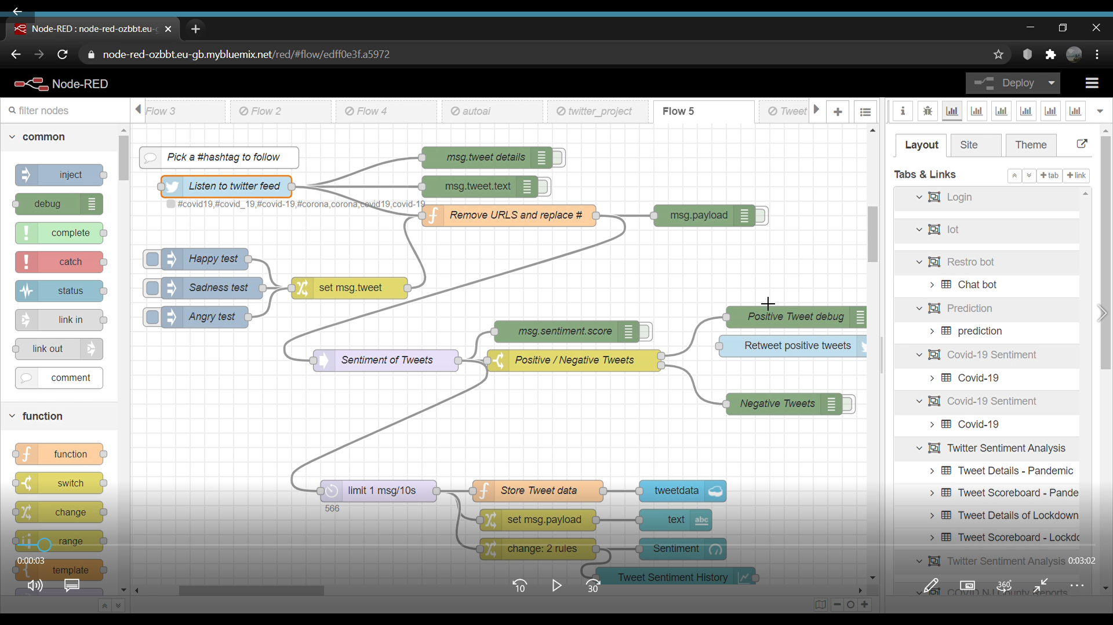

Slide 7
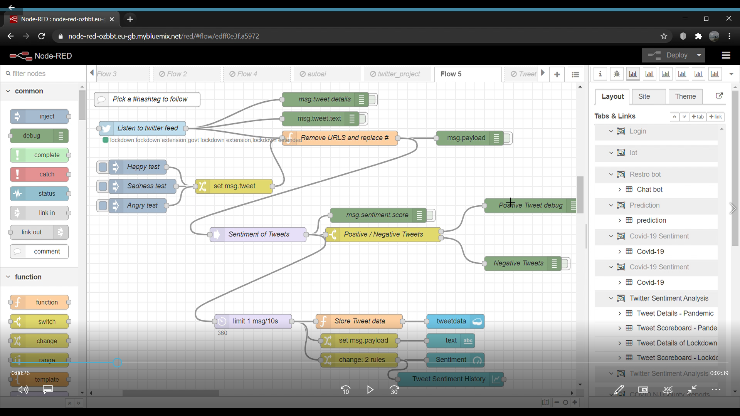

Slide 8
Twitter Sentiment Analysis Dashboard

Slide 9
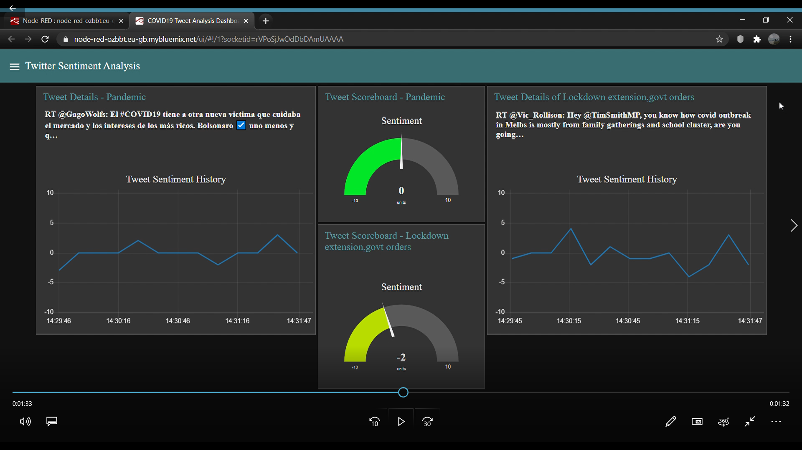

Slide 10
Applications
Social Media Monitoring (SMM).Understand social data like never. Social media is a goldmine of consumer stories and opinion data.
Can predict the reaction of citizens regarding COVID-19 and pandemic effects.
Helpful to companies that during this pandemic what likely people want and people rather prefer not to.

Slide 11
Conclusion
We described how did we implemented "Covid-19 Tweet Analysis Model" using Node-RED and IBM Cloud platforms. The tweet analysis is one of the best ways to find people's sentiment towards certain things but just analyzing tweets. During this pandemic it is way more important to determine fellow people's thoughts and its after effect on the society , market etc. We used the best and more efficient platforms to implement the same. Less coding is the highlight of our project. The dashboard we developed is easy understandable and reliable to people. Tweet analysis thus can be used in many areas like marketing and improve the activities in that particular field.

